Slide 1
Bloom Cookies: Web Search Personalization without User Tracking
Authors: Nitesh Mor, Oriana Riva, Suman Nath, and John Kubiatowicz
Presented by Ben Summers

Slide 2
Outline
Introduction
Personalization and Privacy in Searching
Bloom Cookie
Evaluation
Results
Limitations
Advantages
Questions

Slide 3
Personalization’s Edge
Online services have become increasingly personalized.
Personalization comes from building user profiles on the server side by tracking multiple online activities.
Privacy-concerned users and stricter privacy regulations have made it difficult to build a complete profile without infringing on privacy.
Yet a search engine that provides personalized results while maintaining privacy has a competitive edge.

Slide 4
Outline
Introduction
Personalization and Privacy in Searching
Bloom Cookie
Evaluation
Results
Limitations
Advantages
Questions

Slide 5
Personalization and Privacy
Personalization and privacy are not mutually exclusive
Other works prove it’s possible to maintain user profiles at the client
But they need to put the personalization algorithms on the clients
Communication overhead between client and server is very large
The authors suggest obfuscating profile to preserve user privacy and yet allows personalization

Slide 6
Outline
Introduction
Personalization and Privacy in Searching
Bloom Cookie
Evaluation
Results
Limitations
Advantages
Questions

Slide 7
A Fitted Suit For an Invisible Man
Authors propose Bloom Cookies, which encodes a user’s profile in an efficient and privacy-preserving manner.
They use generalization and noise addition to preserve user privacy and allows the user to personalize results.
Generalization – shares items in a user’s profile only at a coarse granularity
Noise addition – adds fake items to the profile to hide the real items.

Slide 8
What is a Bloom Cookie?
A Bloom Cookie is generated and maintained by the client and sent to online services every time the user makes a service request.
The user controls what profile information is included in the Bloom Cookie and when the cookie is sent.
The authors inject noisy bits into the Bloom filter and exploit false positives naturally occurring in it as noise.

Slide 9
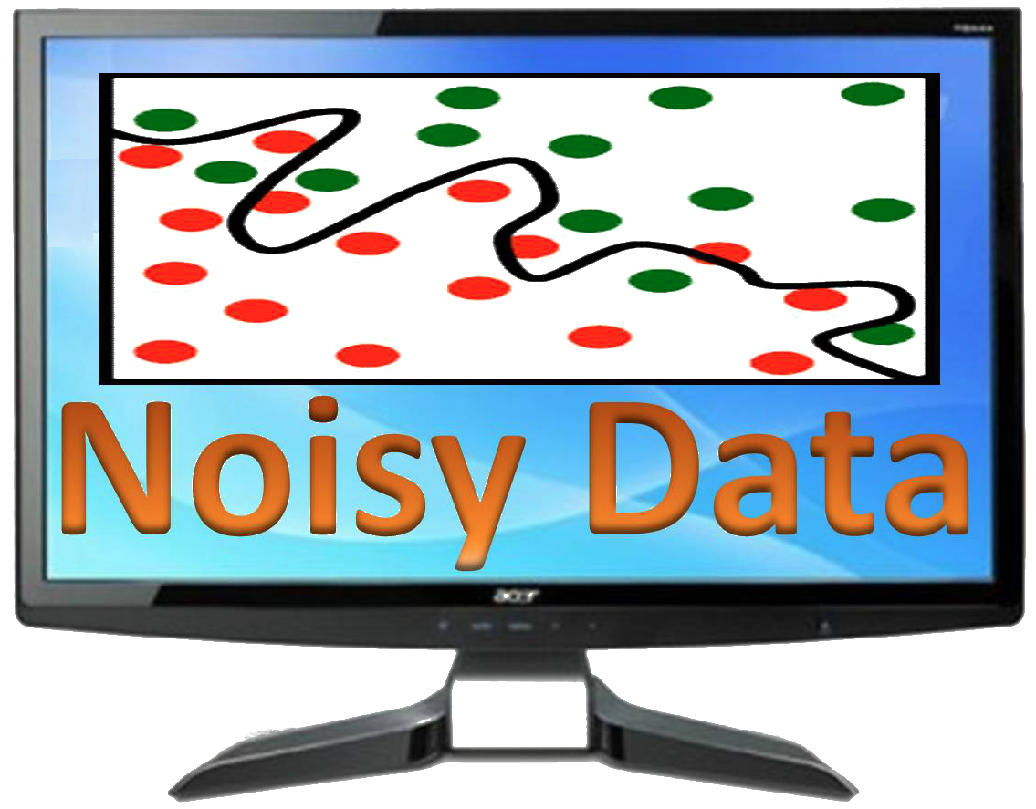
Noise vs. Generalization
Authors found noise addition provides a better privacy tradeoff than generalization.
However, noisy profiles rely on a large communication overhead and need a large noise dictionary provided by a third party.
Bloom Cookies use a smaller noise profile and do not require a noise dictionary.

Slide 10
Contributions
Bloom Cookies provide a convenient privacy, personalization, and network efficiency tradeoff.
The authors also prove that generalization provides anonymity but does not naturally translate into unlinkability.
If a user is able to identify whether two requests are coming from the same or different clients, it can collect info to identify the user over time.
Unlike all previous work, they leverage Bloom filters for privacy.

Slide 11
Web Search Goals
They assume each client is associated with a profile which is made up of URLS that they visit. Assume that a server doesn’t collude with others.
Personalization: Tailor search queries or re-rank search results based on web sites the user visits.
Privacy: Client obfuscates profile before sending it to the server. Unlinkability is key goal.
Add noise so that the server cannot identify if two queries are coming from the same client or different clients.

Slide 12
Unlinkability Goals
Aim for unlinkability across IP-sessions, a sequence of all queries with the same IP source.
Determined that an average home network scenario has an IP-session that lasts about 2 weeks.
Assume that the browser keeps track of the user’s online activity and maintains a profile. This is encoded as a Bloom Cookie and sent with each query.

Slide 13
Obfuscation Design
A noise profile provides a similar level of unlinkability as a generalized profile, but with better personalization.
Negative effect is offset by finer granularity of profile items resulting in net positive improvement.
Size of noise profile can be in tens of kB – larger than actual requests or responses. Impractical.
Bloom Cookies smaller communication overhead and lack of noise dictionary make it practical.

Slide 14
Outline
Introduction
Privacy and Personalization in Searching
Bloom Cookie
Evaluation
Results
Limitations
Advantages
Questions

Slide 15
Evaluation
To build URL-based profiles, they extract a satisfied click, a click follow by a period of inactivity.
They extract clicked URLs and assemble the user profile as a list of domain names ordered by recurrence in the log.
They categorize the log by Google’s ODP categories.
The profiles are then used for ranking search results.

Slide 16
Ranking queries
Assign a score to each of the top 50 results returned for a query. If the domain of the search result is present in a User’s profile, then the result receives a rank of personalization.
They calculate an average rank.
R is the set of results clicked for query i and rank is rank of result as assigned by their personalization algorithm.

Slide 17
Noise Addition Techniques
The authors explored two different techniques for noise addition: RAND and HYBRID.
Both assume a dictionary containing URLS and top-3 ODP categories associated with each URL.
RAND draws fake URLS randomly from D.
HYBRID draws fake URLS only from ODP categories matching the user’s interests.

Slide 18
Outline
Introduction
Privacy and Personalization in Searching
Bloom Cookie
Evaluation
Results
Limitations
Advantages
Questions

Slide 19
Impact of Noise
Both noise techniques provide higher unlinkability – compared to exact profiles where 98.7% users were correctly linked, noise lowers to 20% (RAND) or 13.6% (HYBRID).
But, as they authors said, generating a dictionary for noise addition inflates communication overhead.

Slide 20
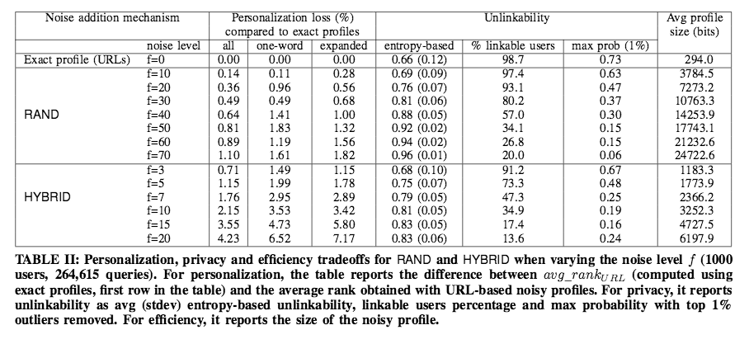
RAND and HYBRID

Slide 21
Bloom Cookies
A Bloom filter is used to store elements from a set E and is implemented as a bit string with k hash functions.
When querying if an element exits in the Bloom filter, false positives exist but false negatives do not.
They generate the noisy profile and insert the URLS from it into a Bloom filter, which the clients sends with queries.
The server queries the Bloom filter for all URLS contained in the search results from the submitted query and reranks accordingly.

Slide 22
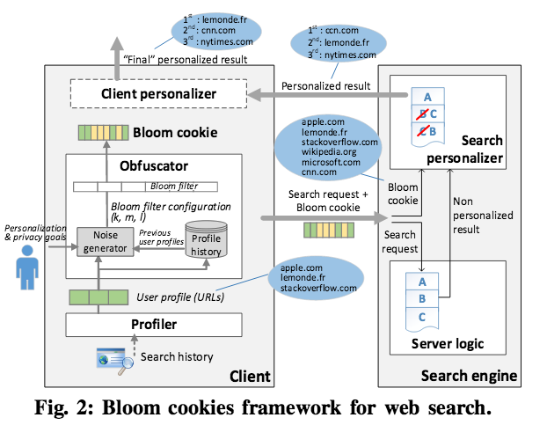
Framework for Web Search

Slide 23
Controlling Obfuscation
Obfuscation can be controlled by changing the number of hash functions and level of noise in the Bloom filter.
When increasing k (hash), probability is reduced and reduces noise bits controlled by l.
Increasing m (noise) increases unlinkability.
The authors provide an algorithm for configuring Bloom Cookies, one that considers personalization and privacy.

Slide 24
Personalization/Privacy/Efficiency Tradeoffs

Slide 25
Outline
Introduction
Privacy and Personalization in Searching
Bloom Cookie
Evaluation
Results
Limitations
Advantages
Questions

Slide 26
Limitations
More users than the dataset they used are likely to improve the privacy of Bloom Cookies – more users in the system means a user’s noisy profile is more likely to collide with another user
Some users activity may be so distinct that even with noise added, they could be linkable – feedback from those users is needed.
Authors’ assumptions of current techniques of web search could become wrong. Different services might share the data and personalization algorithms might become more sophisticated.
Tracking across services is outside their bounds – they just chose web search for its mature personalization.

Slide 27
Outline
Introduction
Privacy and Personalization in Searching
Bloom Cookie
Evaluation
Results
Limitations
Advantages
Questions

Slide 28
Advantages of Bloom Cookies
Efficient
Noisy by design
Noise is non-deterministic
Dictionary free
Dictionary attacks are much more expensive
Provide better unlinkability than HYBRID for the same level of personalization!
Notes:
Answers:

Slide 29
Outline
Introduction
Privacy and Personalization in Searching
Bloom Cookie
Evaluation
Results
Limitations
Advantages
Questions

Slide 30
Questions
What are two advantages of Bloom Cookies over generalization?
Why can’t the authors solely use the RAND or HYBRID noise addition techniques they outlined in the paper to add noise to their profiles?
What two parameters do the authors use to control the efficiency/personalization/privacy tradeoffs of Bloom Cookies?
Notes:
ANSWERS: Efficient
Noisy by design
Noise is non-deterministic
Dictionary free
Dictionary attacks are much more expensive
Provide better unlinkability then HYBRID for the same level of personalization!
2. Those techniques rely on dictionaries and introduce a lot of communication overhead.
3. They control the number of hashes and the noise level to manipulate the privacy/personalization tradeoff

